Slide 1
Coaching Investors Through Volatile Times
Steve Wendel
Head of Behavioral Science
Morningstar, Inc.

Slide 2
Predictably Irrational
Buy high
Sell low
Notes:
The investor’s chief problem – and even his worst enemy – is likely to be himself.
The investor’s chief problem – and even his worst enemy – is likely to be himself.
Barber and Odean- Trading is bad for your wealth

Slide 3
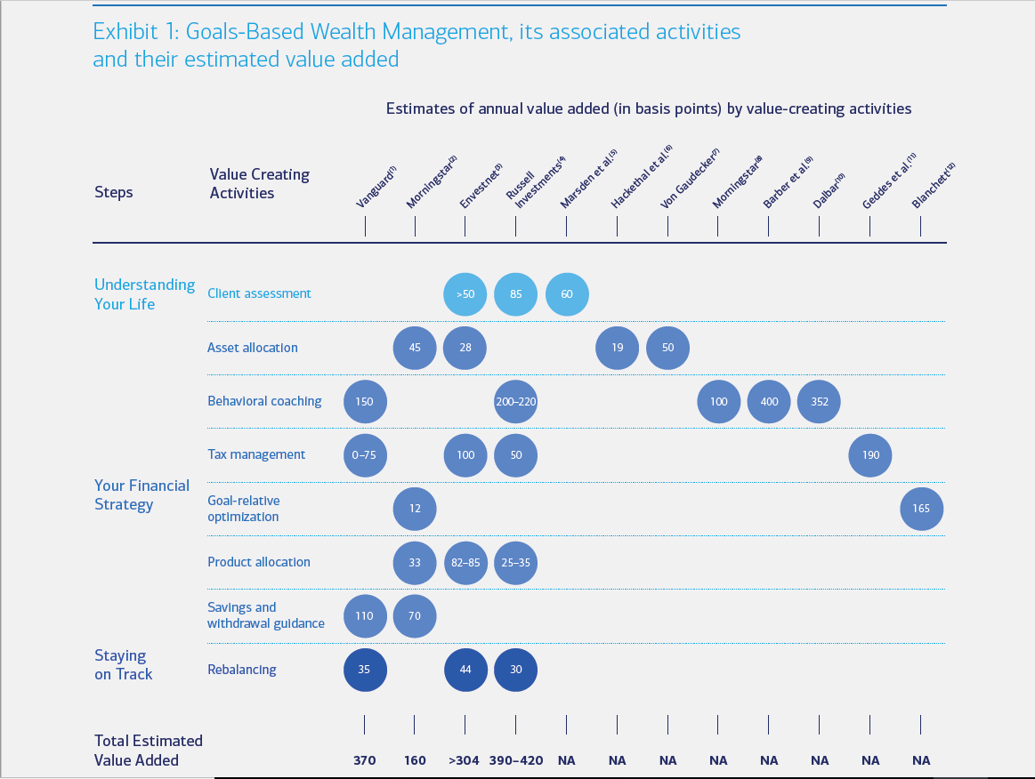
Notes:
Merrill Lynch, 2016

Slide 4
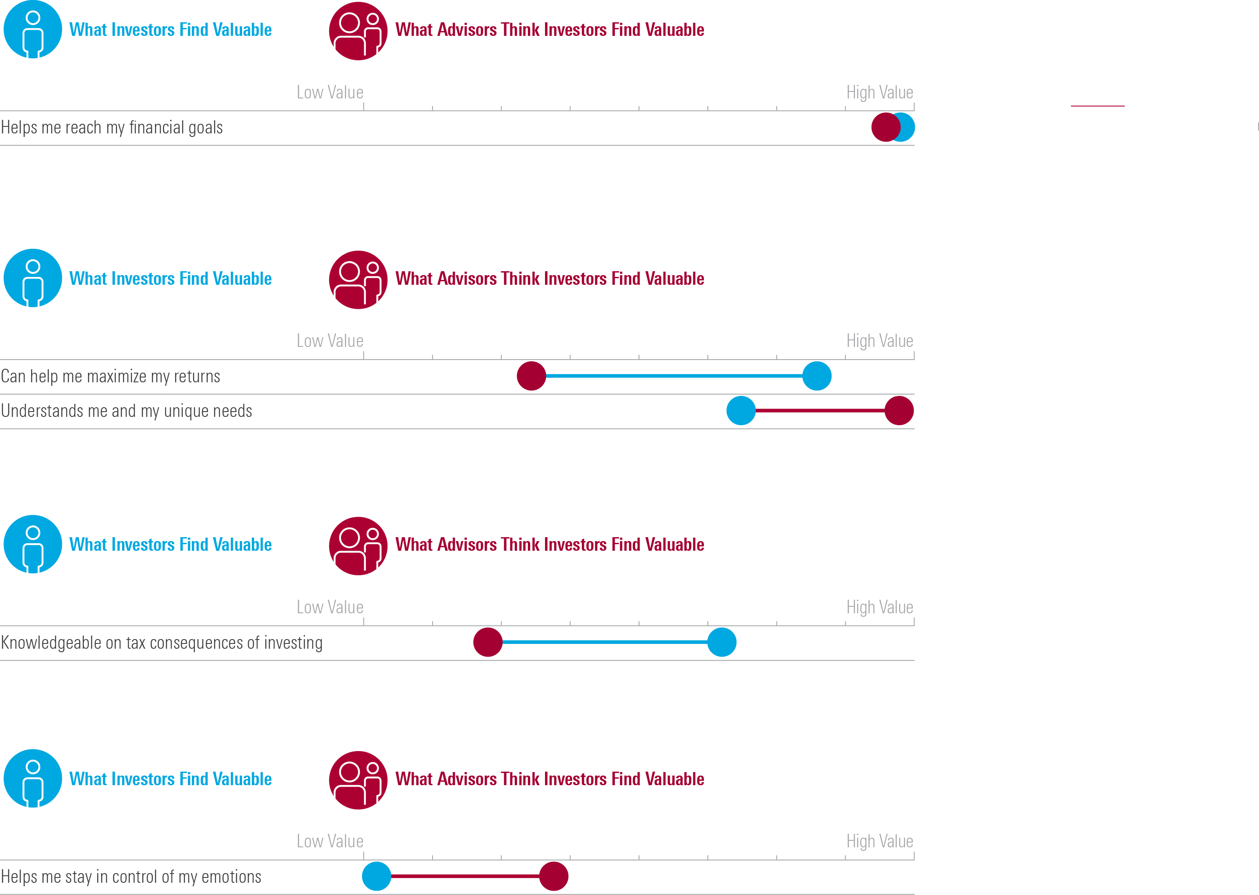
Investors Don’t See That Emotions Can Cloud Investing Judgment
Investors under-estimate the importance of advisors in helping to manage their emotions
          The investor’s chief problem – and even his worst enemy – is likely to be himself.
          -Benjamin Graham
Notes:
The investor’s chief problem – and even his worst enemy – is likely to be himself.
The investor’s chief problem – and even his worst enemy – is likely to be himself.
Barber and Odean- Trading is bad for your wealth

Slide 5
Both Advisors and Investors Agree Goals Are Important
Goals are top priority for investors and advisors

Slide 6
Agenda
The problem of panic: what’s at stake
Why it happens
What you can do about it
Wrap up

Slide 7

Meet John
35 years old
IT entrepreneur
1m in assets
Just starting to invest
For Financial Advisor Use Only. Not for use with the public.
Notes:
UPDATE IMAGE

Slide 8

He meets with you, as his new advisor

Slide 9

You offer a great plan. Thank you.
Notes:
Shutterstock

Slide 10

But things happen, and he calls you.
Notes:
Shutterstock

Slide 11

The dreaded call

Slide 12

Ideally, you could calm him down.
Notes:
Shutterstock

Slide 13
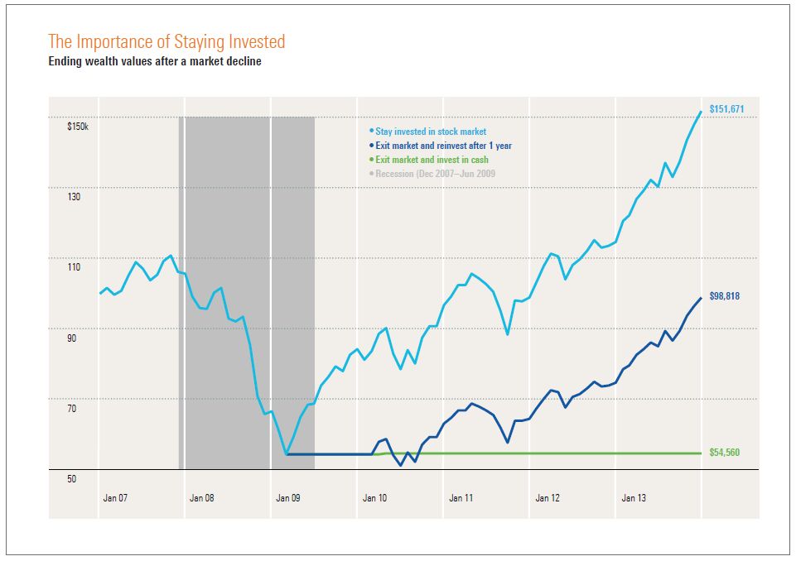
We all know how this can play out…
Notes:
Shutterstock

Slide 14

Does he bail on his investments or on you?
Notes:
Shutterstock

Slide 15

Do you help John destroy his wealth,
or do you lose him as a client?
Notes:
Shutterstock

Slide 16
Agenda
The problem of panic: what’s at stake
Why it happens
What you can do about it
Wrap up

Slide 17
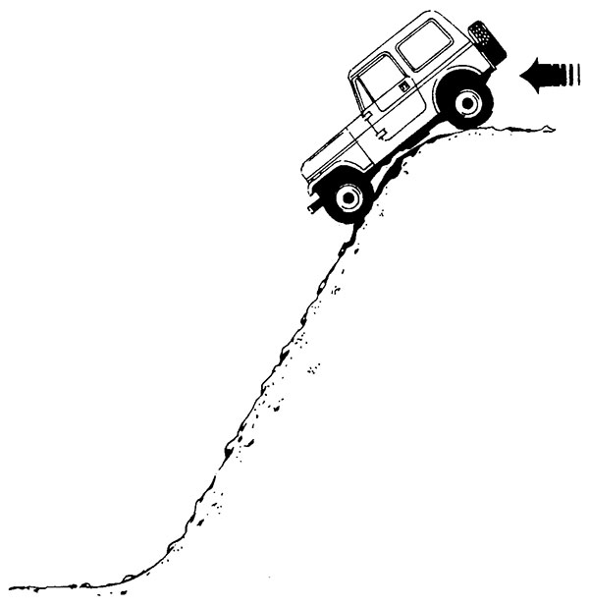
Recent experience is usually a pretty good guide
Notes:
http://www.sciencedirect.com/science/article/pii/S0167487006001048

Slide 18
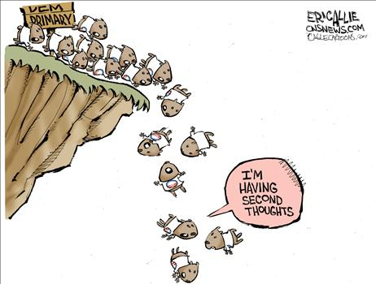
Other people send a strong signal of what to do
Notes:
http://www.sciencedirect.com/science/article/pii/S0167487006001048

Slide 19

They want you to take action!
Action bias among elite soccer goalkeepers: The case of penalty Kicks, 2007
Notes:
http://www.sciencedirect.com/science/article/pii/S0167487006001048

Slide 20

He knows what’s wise, but he still struggles internally
Notes:
Shutterstock

Slide 21
Agenda
The problem of panic: what’s at stake
Why it happens
What you can do about it
Wrap up

Slide 22

Tackle the psychology of anxiety directly
For Financial Advisor Use Only. Not for use with the public.
Notes:
Shutterstock

Slide 23

Five steps along the rocky path, five potential solutions
Investments
Information
Emotion
Decision
Action
Notes:
Shutterstock

Slide 24

Solution 1: Change the investments
Neither asset allocation or diversification guarantee a profit or protect against loss in declining markets.
Notes:
Shutterstock; Bucket Strategy

Slide 25
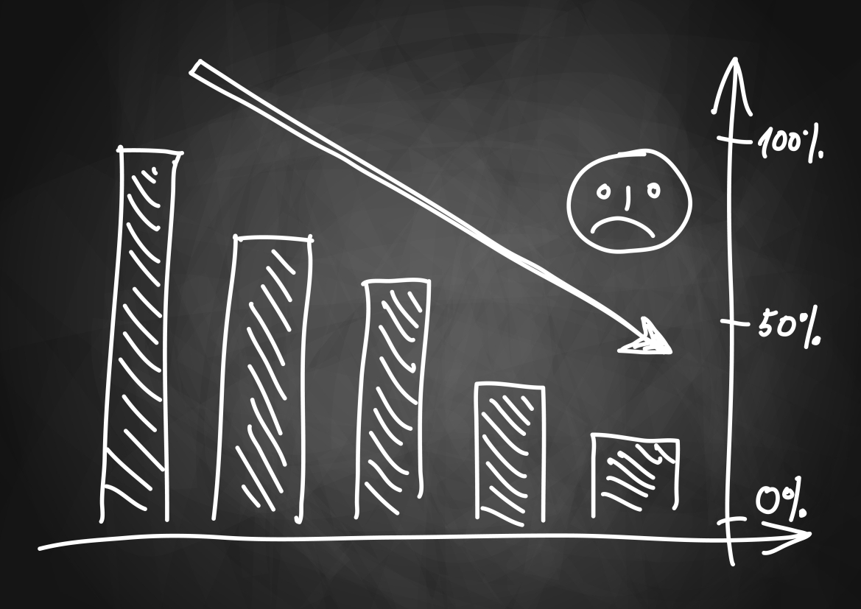
Solution 1b: Change the investments
Neither asset allocation or diversification guarantee a profit or protect against loss in declining markets.
Notes:
Shutterstock; Bucket Strategy

Slide 26

Solution 2: Change the information
For Financial Advisor Use Only. Not for use with the public.
Notes:
Shutterstock

Slide 27
Solution 2b: Change the information
“I bought the paper fresh each day. I went wild with love, anger, irritation, frustration; all of the passions boiled in me.
So I learned to stand back away and let the paper age and mellow…I saw the headlines diminish into nothing.”
-Ray Bradbury, And the Rock Cried Out
Notes:
Shutterstock

Slide 28

Solution 3: Change the emotion
Notes:
Shutterstock; Investor

Slide 29
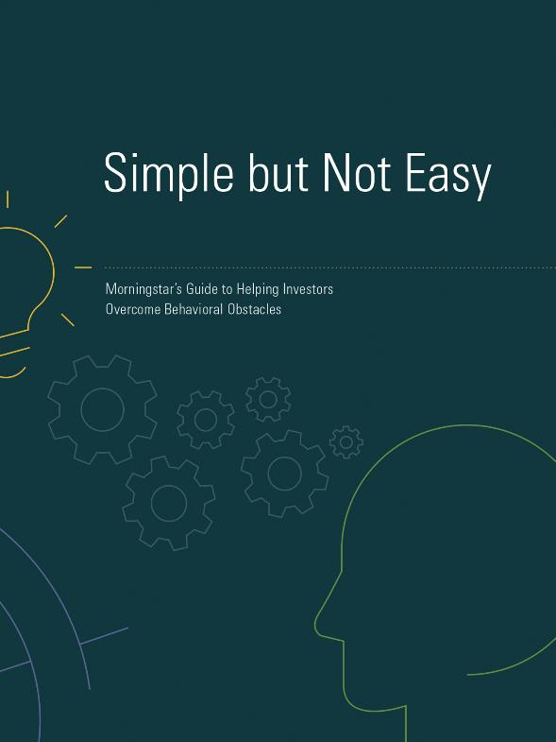
See our guide: “Simple But Not Easy”
http://www.morningstar.com/lp/advisor-toolkit

Slide 30

Solution 3b: Change the emotion
For Financial Advisor Use Only. Not for use with the public.
Notes:
Shutterstock; Investor

Slide 31
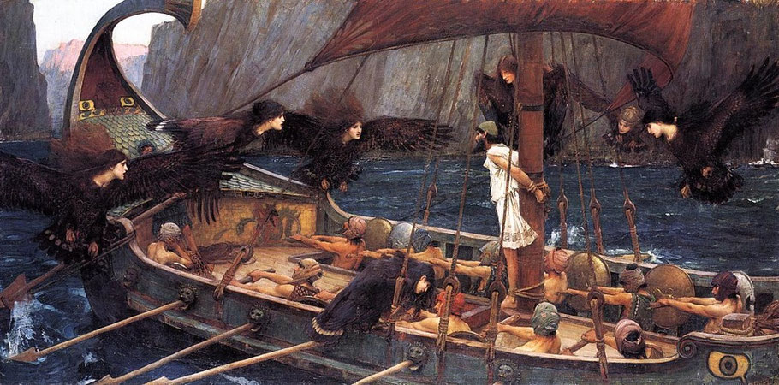
Solution 4: Change the decision
See: Ashraf et al. (2006)
Notes:
Shutterstock

Slide 32

Solution 4b: Change the decision
See: Egan (2015)
Notes:
Shutterstock

Slide 33

Solution 5: Change the action
Notes:
Shutterstock

Slide 34

Change the environment,
not the person.
For Financial Advisor Use Only. Not for use with the public.

Slide 35
Where we’ve been
The problem of panic: what’s at stake
Why it happens
What you can do about it
Wrap up

Slide 36
We dread the panicked call
Notes:
Shutterstock

Slide 37
But it’s not unreasonable – it’s how we’re wired
Notes:
http://www.sciencedirect.com/science/article/pii/S0167487006001048

Slide 38
Five steps along the rocky path, five potential solutions
Investments
Information
Emotion
Decision
Action
Notes:
Shutterstock

Slide 39

There’s much we can do
Notes:
Shutterstock

Slide 40

To help John, and your business succeed
For Financial Advisor Use Only. Not for use with the public.
Notes:
Shutterstock

Slide 41
Questions? Comments?
ray.sin@morningstar.com
http://www.morningstar.com/lp/advisor-toolkit

Slide 42
Important Information
This document is issued by Morningstar Investment Management Australia Limited (ABN 54 071 808 501, AFS LicenceNo. 228986) (‘Morningstar’). © Copyright of this document is owned by Morningstar and any related bodies corporate that are involved in the document’s creation. As such the document, or any part of it, should not be copied, reproduced, scanned or embodied in any other document or distributed to another party without the prior written consent of Morningstar. The information provided is for general use only.
In compiling this document, Morningstar has relied on information and data supplied by third parties including information providers (such as Standard and Poor’s, MSCI, Barclays, FTSE). Whilst all reasonable care has been taken to ensure the accuracy of information provided, neither Morningstar nor its third parties accept responsibility for any inaccuracy or for investment decisions or any other actions taken by any person on the basis or context of the information included.
Past performance is not a reliable indicator of future performance. Morningstar does not guarantee the performance of any investment or the return of capital. Morningstar warns that (a) Morningstar has not considered any individual person’s objectives, financial situation or particular needs, and (b) individuals should seek advice and consider whether the advice is appropriate in light of their goals, objectives and current situation. Refer to our Financial Services Guide (FSG) for more information at morningstarinvestments.com.au/fsg.
Before making any decision about whether to invest in a financial product, individuals should obtain and consider the disclosure document. For a copy of the relevant disclosure document, please contact our Adviser Solutions Team on 1800 951 999.
This commentary contains certain forward-looking statements. We use words such as “expects”, “anticipates”, “believes”, “estimates”, “forecasts”, and similar expressions to identify forward-looking statements. Such forward-looking statements involve known and unknown risks, uncertainties and other factors which may cause the actual results to differ materially and/or substantially from any future results, performance or achievements expressed or implied by those projected in the forward-looking statements for any reason.
42

